Slide 1
PROJECT OVERVIEW
BY
Sai Sree Raja
Data Analyst Intern
At
UNIFIED MENTOR

Slide 2
TABLE OF CONTENTS
Project-1
Employee Attrition Defination
Problem Statement
Problem Overview
Data sources
Description
Data Details
KPIs
Dashboard
Project learning
Project-2
Introduction
Objective
Problem Statement
Problem Overview
Benfits
KPIs
Dashbaord
Project Learning

Slide 3
PROJECT-1 EMPLOYEE ATTRITION DATA ANALYSIS

Slide 4
Employee Attrition Means:
Employee attrition occurs when the size of your workforce diminishes over time due to unavoidable factors such as employee resignation for personal or professional reasons.
Employees are leaving the workforce faster than they are hired, and it is often outside the employer’s control. For example, let’s say that you have opened a new office designated as the Sales Hub for your company. Every salesperson must work out of this office-but a few employees cannot relocate and choose to leave the company. This is a typical reason for employee attrition.
But there are other reasons for attrition as well, including the lack of professional growth, a hostile work environment, or declining confidence in the company’s market value. Weak leadership is another factor that often drives attrition among employees.

Slide 5
Problem Statement:
XYZ Company, established a few years back, has been experiencing an approximately 15% attrition rate for a couple of years. This issue has significantly impacted the company across various aspects. In an effort to understand why employees are leaving and to reduce the attrition rate, XYZ Company has approached an HR analytics consultancy to analyse the available data. You are playing the role of an HR analyst in this project, tasked with building a dashboard that can assist the organization in making data-driven decisions.

Slide 6
Project Overview:
The objective of this project is to gain insights into the factors influencing employee attrition and performance within the organization by performing data analysis on employee dataset.
To identify patterns, trends, and potential areas for improvement that can help the company better understand and manage employee attrition.
Tools used in this project are Power Query, Microsoft Power Bi.

Slide 7
Data Source:
The raw data for this project was obtained in the form of csv file with 29 columns and approximately 4.4k rows. The data contained information about employee demographics, job roles, salaries, tenures, among others.
Data Cleaning/Transformation:
Checked for Duplicates.
Checked for Null/Blank values.
Replaced null values with statistical central tendency using mode.
Added new columns such as age group, attrition counts, salary slab.

Slide 8
DESCRIPTION:
The Employee Attrition dataset comprises data on employee demographics, job characteristics, and personal factors, aimed at analysing turnover within an organization. Key columns include Employee ID, Age, Attrition status, Department, Job Role, Monthly Income, Total Working Years, and Job Satisfaction. This dataset is essential for identifying factors that contribute to employee attrition and developing strategies to improve retention. By analysing attributes such as Business Travel, Distance From Home, and Years At Company, companies can gain insights into employee behaviour and implement targeted interventions to enhance satisfaction and reduce turnover.

Slide 9
DATA DETAILS: Employee ID: A unique identifier assigned to each employee. Age: The age of the employee. Attrition: Indicates whether the employee has left the company (Yes or No). Business Travel: Frequency of business travel (e.g., Rarely, Frequently). Department: The department in which the employee works (e.g., Sales, Research & Development, Human Resources). Distance From Home: The distance (in kilometres or miles) between the employee's home and workplace. Education: The highest level of education achieved by the employee (numeric scale). Education Field: The field of study for the highest level of education (e.g., Life Sciences, Medical, Marketing). Gender: The gender of the employee (e.g., Male, Female). Job Level: The level of the employee's job position within the company. Job Role: The specific role or title of the employee (e.g., Sales Executive, Research Scientist). Marital Status: The marital status of the employee (e.g., Single, Married, Divorced). Monthly Income: The monthly income of the employee. Num Companies Worked: The number of companies the employee has worked for prior to the current organization.
.

Slide 10
Key Performance Indicators (KPIs) : For the Analysis, I have identified the KPIs to track and monitor employee performance and attrition. The following KPIs were designed to address. There are various type of KPIs which belong to employee attrition data and which are shown in figures.

Slide 11
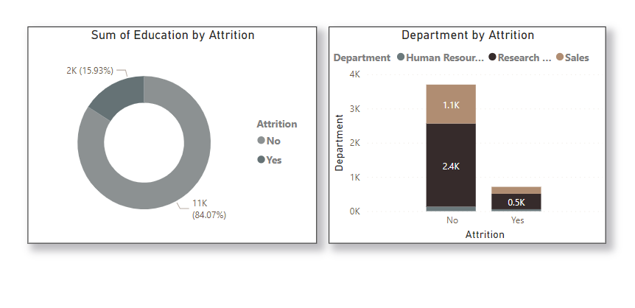
KPI-1

Slide 12
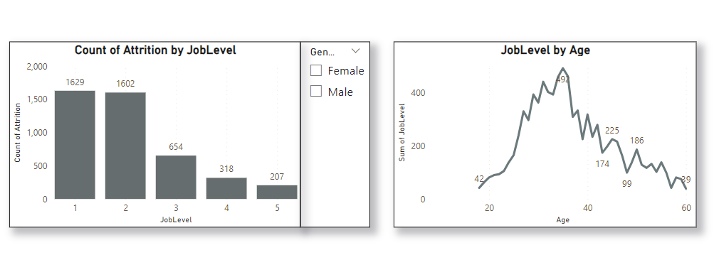
KPI-2

Slide 13
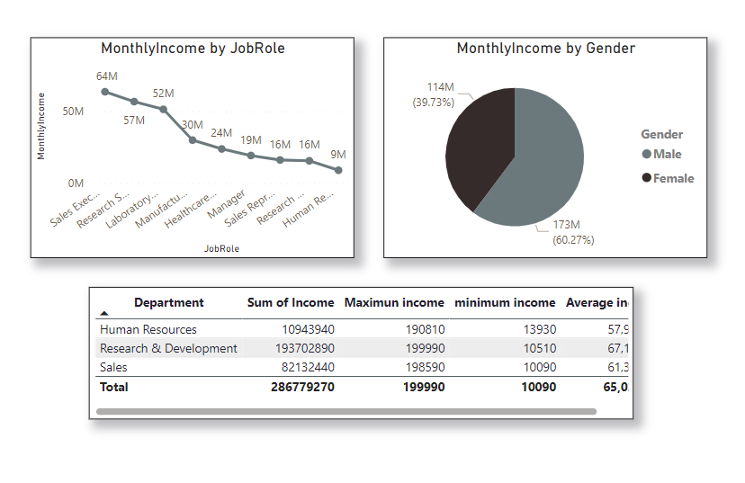
KPI-3

Slide 14
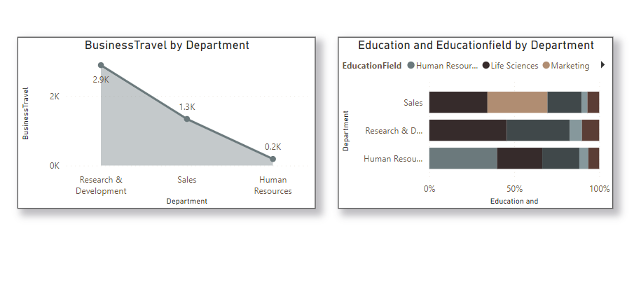
KPI-4

Slide 15
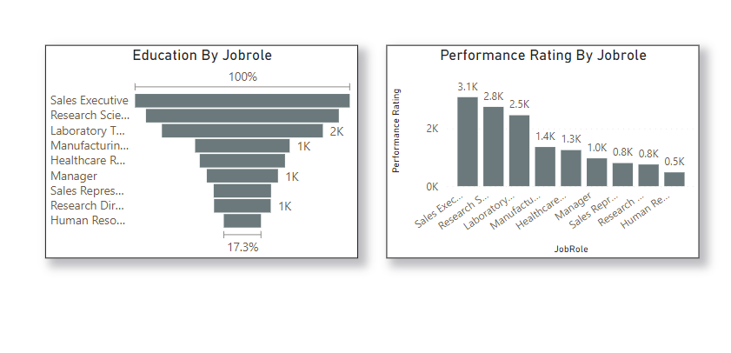
KPI-5

Slide 16
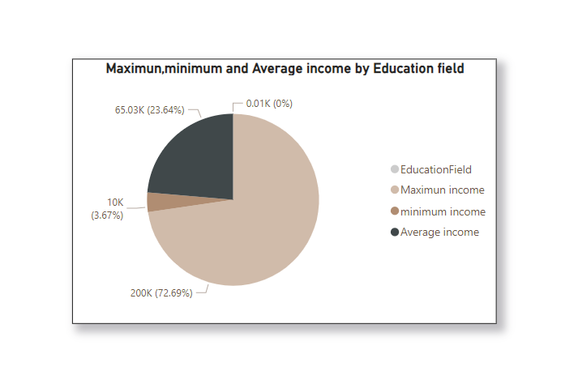
KPI-6

Slide 17
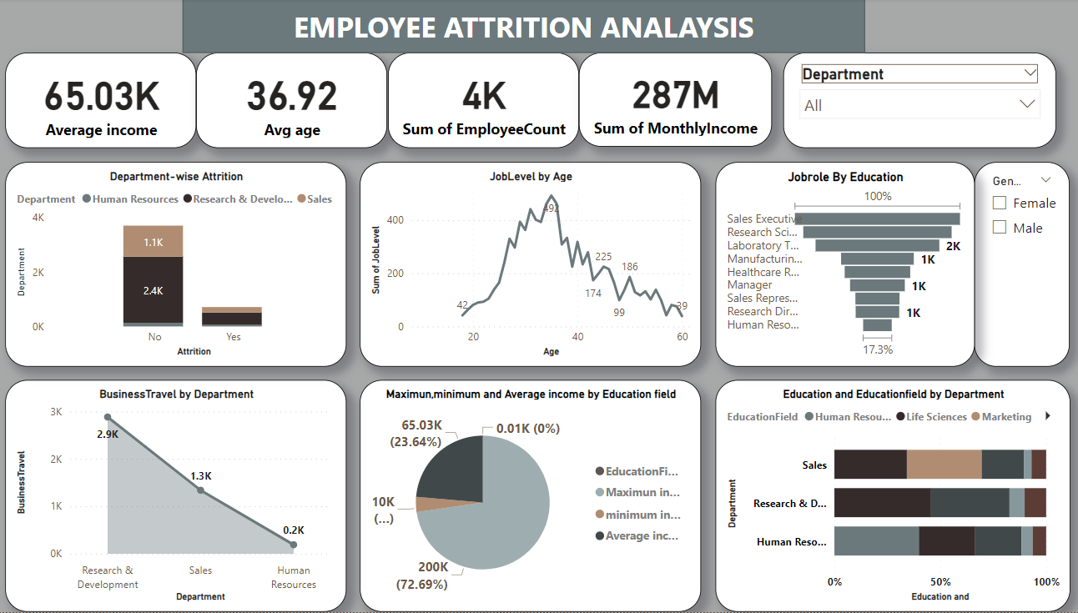
DASHBOARD

Slide 18
Project Learning :
Developed an interactive dashboard with advance filtering options and slicers to analyzing employee performance and attrition effectively.
Utilized complexed DAX queries to create customized columns and perform data manipulation for insightful analysis.
Incorporated various visualization types such as bar charts, area charts, matrix tables, donut charts, slicers and KPIs cards for comprehensive data representation.
Analysed data to provide practical advice on boosting employee satisfaction and retention, aiming to enhanced overall workforce engagement.

Slide 19
PROJECT-2

Slide 20
PROJECT-2 AMAZON SALESDATA ANALYSIS

Slide 21
INTRODUCTION
Offering millions of products for online purchase, Amazon is a global leader in e-commerce. Beyond just retail, it now offers cloud computing services and creates smart home appliances.
The relevance of sales management has increased in response to the growing competition and the demand for better distribution strategies that lower costs and boost profitability.
The sales trend for each month-wise, year-wise, and yearly-month-wise is included in this project, along with important metrics and elements that highlight the significant connections between the various features.

Slide 22
OBJECTIVE
Sales management has gained importance to meet increasing competition and the need for improved methods of distribution to reduce cost and to increase profits. Sales management today is the most important function in a commercial and business enterprise

Slide 23
PROBLEM STATEMENT
Develop a Report by Extracting-Transforming-Loading of data which contains Sales trend with respect to Yearly-wise.
Month-wise, Yearly and month-wise and find Some relationships through data to understand and Analyze the Facts.

Slide 24
PROJECT OVERVIEW
Performing ETL (Extract-Transform-Load) on Amazon dataset to find Sales Trend : Month-wise, Year-wise, Yearly Month-wise.
To Find KPIs and factors to show the meaningful relationships between attributes.
To Recognize sales management as the cornerstone of success in the commercial and business landscape.
To Showcase the power of visual representation through a dynamic Power BI dashboard To Utilizing diverse set of visualizations, including clustered column charts, line charts, tree maps, filled maps, slicers, and cards, to present a comprehensive view of sales data.
Unearthing insights into monthly and yearly sales trends, unit sales correlations, regional profit dynamics, and order priority analysis.

Slide 25
BENFITS
Help out to make better business decisions.
Help analyze customer trends and satisfaction, which can lead to new and better products and services.
Gives better insight of customers base.
Helps in easy flow for managing resources

Slide 26
KEEP PERFORMING INDICATOR(KPIs)
As an Amazon seller, it’s critical to track various KPIs (key performance indicators) in order to understand how your business performs and make necessary adjustments to improve your results. You can’t just guess or think your business is performing well!
By tracking Amazon KPIs, you will have a solid understanding of the performance of each one of your products, your business performance as a whole, and the health of your Amazon account.
In this article, we’ll explore the most important Amazon seller performance metrics you should be tracking to ensure your business is performing at the highest level.

Slide 27
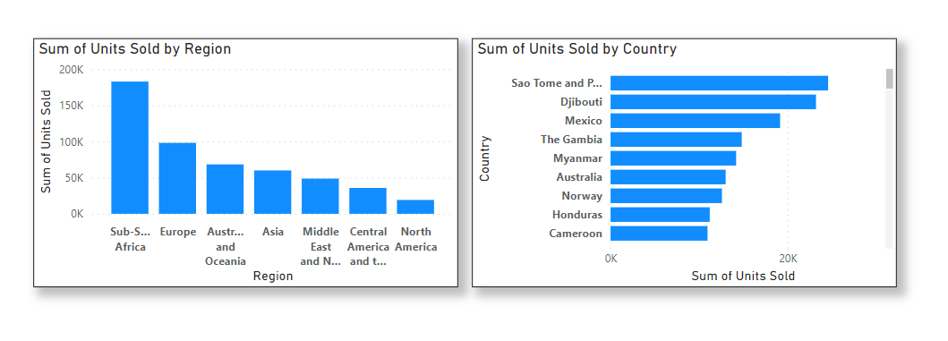
KPI-1

Slide 28
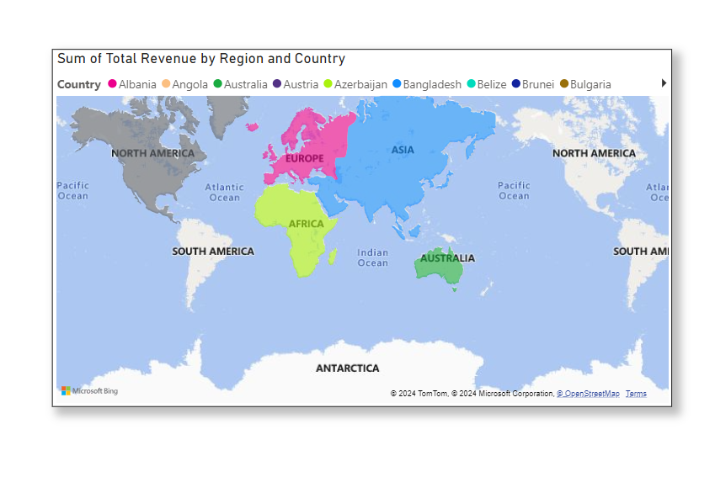
KPI-2

Slide 29
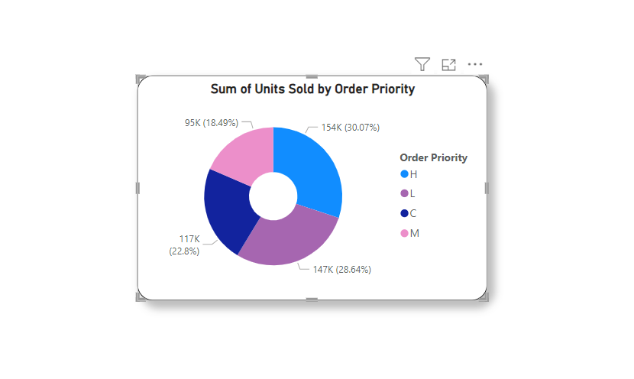
KPI-3

Slide 30
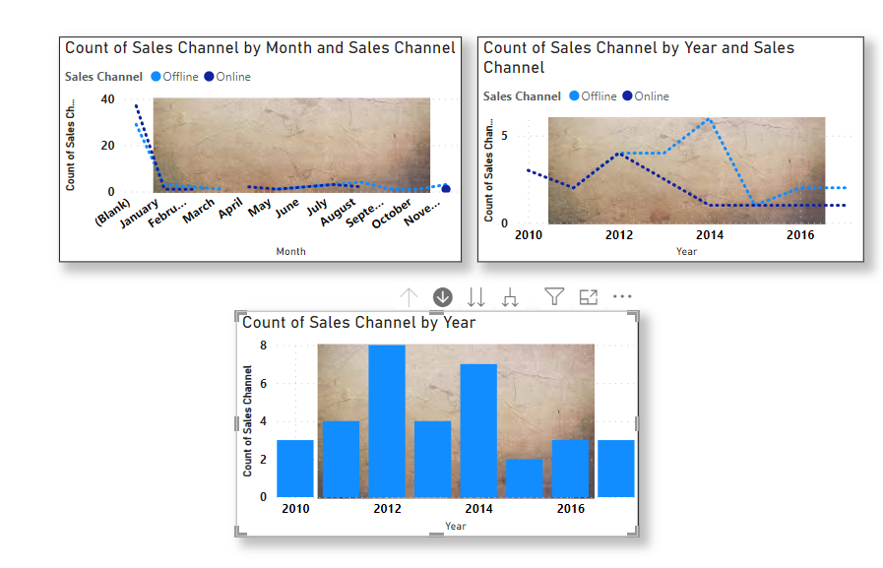
KPI-4

Slide 31
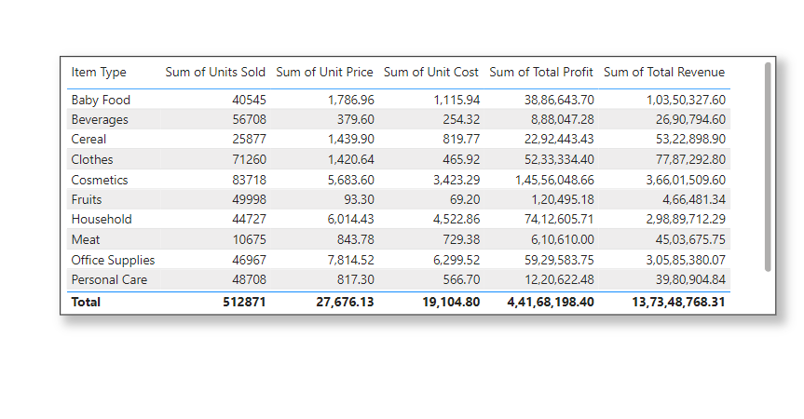
KPI-5

Slide 32
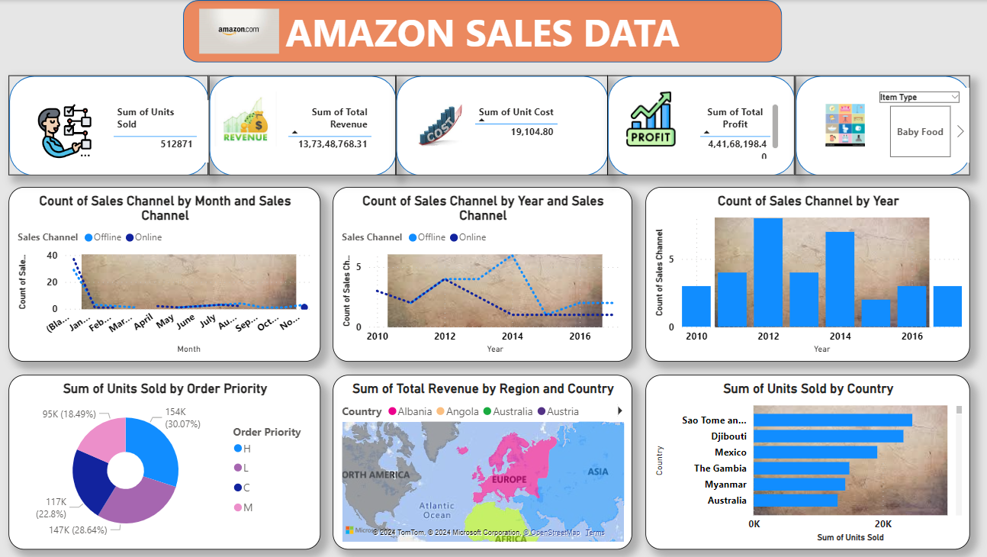
DASHBOARD

Slide 33
Project Learning
Conclusion:
This project provides actionable insights into Amazon's sales performance, customers behaviour and product trends. The analysis demonstrates the importance of data-driven decision-making in enhancing sales strategies and improving customer satisfaction.
Future Work:
Extend the analysis to include customer feedback and reviews to gain deeper insights into customer satisfaction.
Implement predictive analytics to forecast future sales trends based on historical data.
Explore the impact of marketing campaigns on sales performance

